Slide 1
History of Numbers
Tope Omitola and Sam Staton
University of Cambridge
Notes:
Introduce ourselves here

Slide 2
What Is A Number?
What is a number?
Are these numbers?
  Is 11 a number?
  33?
  What about 0xABFE? Is this a number?

Slide 3
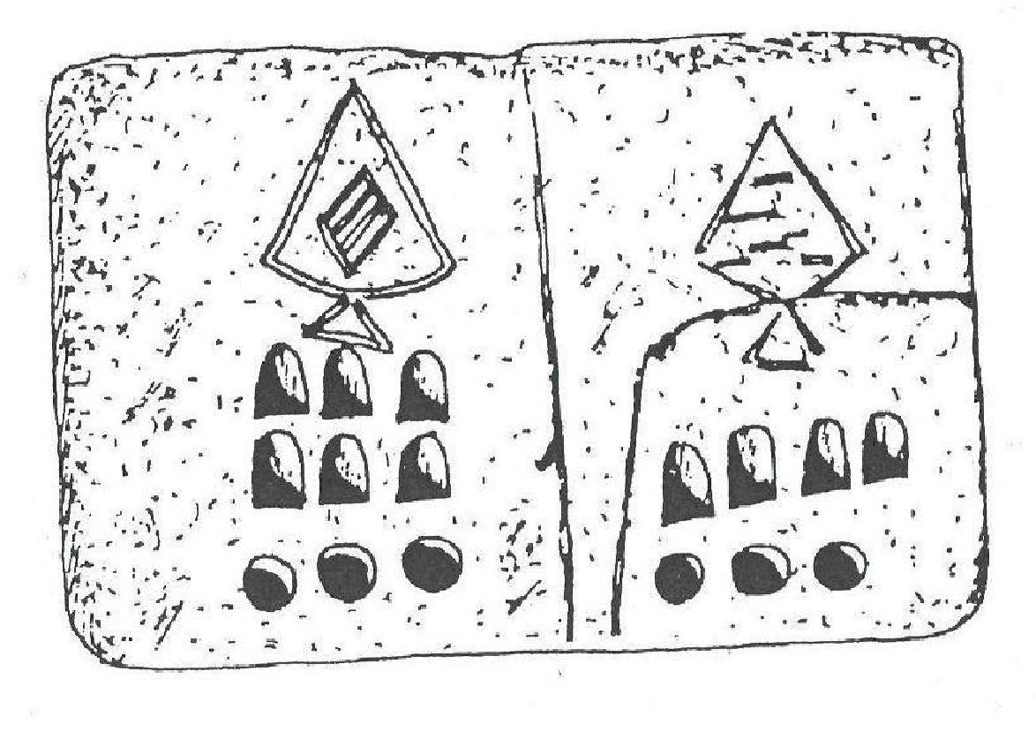
Some ancient numbers

Slide 4
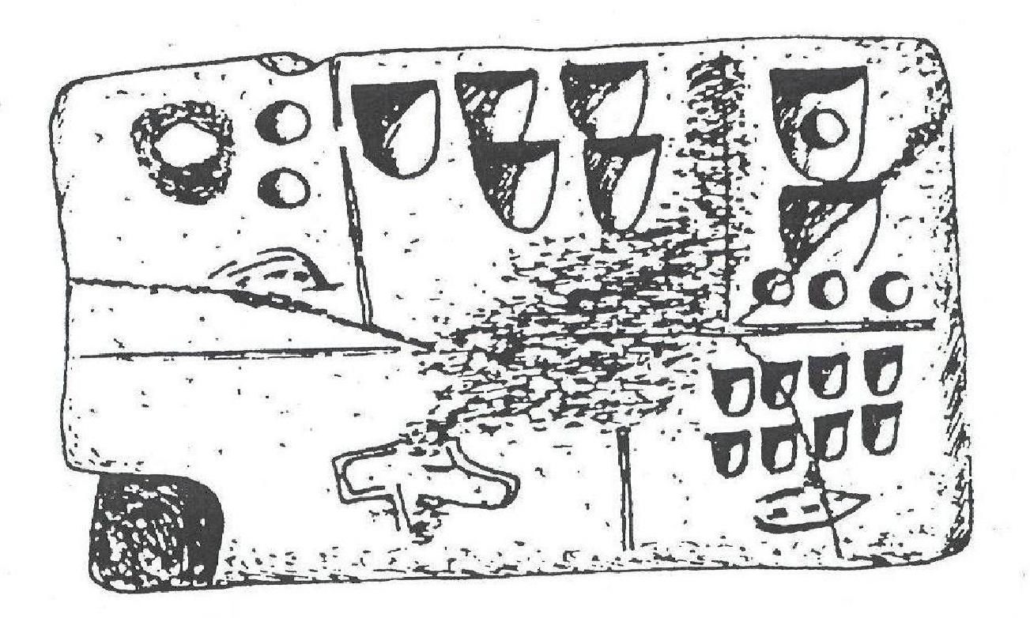
Some ancient numbers

Slide 5
Take Home Messages
The number system we have today have come through a long route, and mostly from some far away lands, outside of Europe.
They came about because human beings wanted to solve problems and created numbers to solve these problems.
Notes:
Take Home Messages:
*The number system we have today have come through a long route, and mostly from some far away lands, outside of Europe.
* They came about because human beings wanted to solve problems and created numbers to solve these problems.

Slide 6
Limit of Four
Take a look at the next picture, and try to estimate the quantity of each set of objects in a singe visual glance, without counting.
Take a look again.
More difficult to see the objects more than four.
Everyone can see the sets of one, two, and of three objects in the figure, and most people can see the set of four.
But that’s about the limit of our natural ability to numerate. Beyond 4, quantities are vague, and our eyes alone cannot tell us how many things there are.

Slide 7
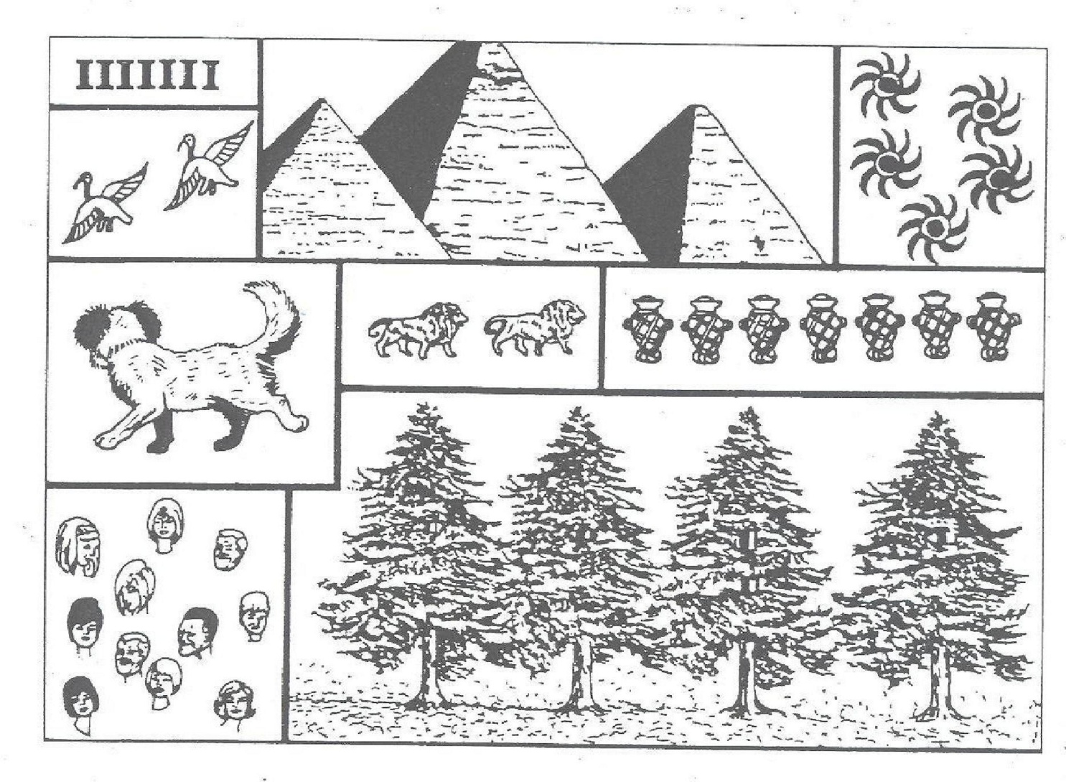
Limits Of Four
Notes:
Take a look at this picture, and try to estimate the quantity of each set of objects in a singe visual glance, without counting.
Take a look again.
More difficult to see the objects more than four.
Everyone can see the sets of one, two, and of three objects in the figure, and most people can see the set of four.
But that’s about the limit of our natural ability to numerate. Beyond 4, quantities are vague, and our eyes alone cannot tell us how many things there are.

Slide 8
Some solutions to “limit of four”
Different societies came up with ways to deal with this “limit of four”.
Notes:
Different societies came up with ways to deal with this “limit of four”.

Slide 9
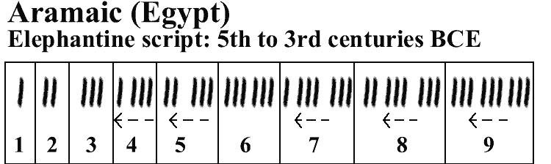
Egyptian 3rd Century BC

Slide 10
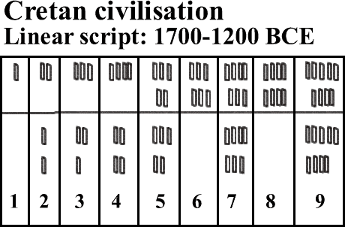
Cretan 1200-1700BC

Slide 11
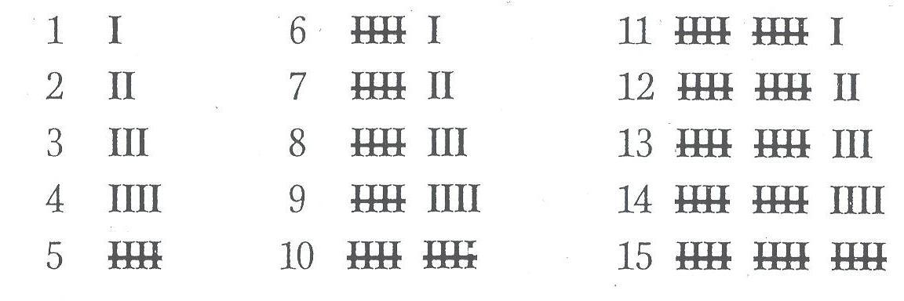
England’s “five-barred gate”

Slide 12
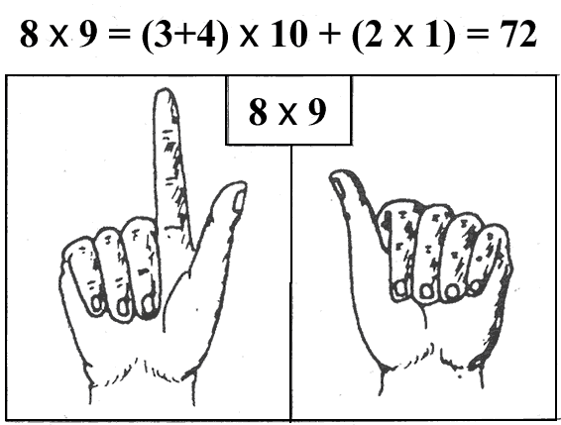
How to Count with
“limit of four”
An example of using fingers to do 8 x 9
Notes:
Close on one hand as many fingers as the excess of 8 over 5, namely 3, keeping the other 2 fingers extended. On the second hand, close as many fingers as the excess of 9 over 5, namely 4, leaving the 5th finger extended. Mentally multiply by 10 the total number of closed fingers (10 x 7 = 70), multiply together the numbers of extended fingers on the 2 hands (2 x 1 = 2), and finally add these 2 results together to get 72. That is to say:
8 x 9 = (3 + 4) x 10 + (2 x 1) = 72

Slide 13
Calculating With Your Finger
A little exercise:
How would you do 9 x 7 using your fingers?
Limits of this: doing 12346 x 987

Slide 14
How to Count with “limit of four”
Here is a figure to show you what people have used.
The Elema of New Guinea

Slide 15
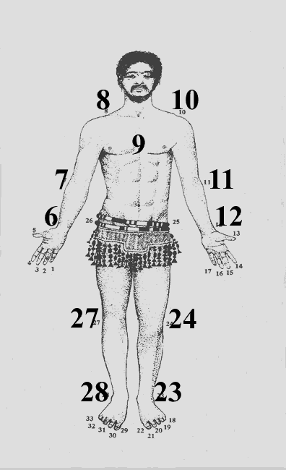
The Elema of New Guinea

Slide 16
How to Count with “limit of four”
A little exercise:
Could you tell me how to do 2 + 11 + 20 in the Elema Number System?
Very awkward doing this simple sum.
Imagine doing 112 + 231 + 4567

Slide 17
Additive Numeral Systems
Some societies have an additive numeral system: a principle of addition, where each character has a value independent of its position in its representation
Examples are the Greek and Roman numeral systems
Notes:
Some societies additive numeral system: a principle of addition, where each character has a value independent of its position in its representation

Slide 18
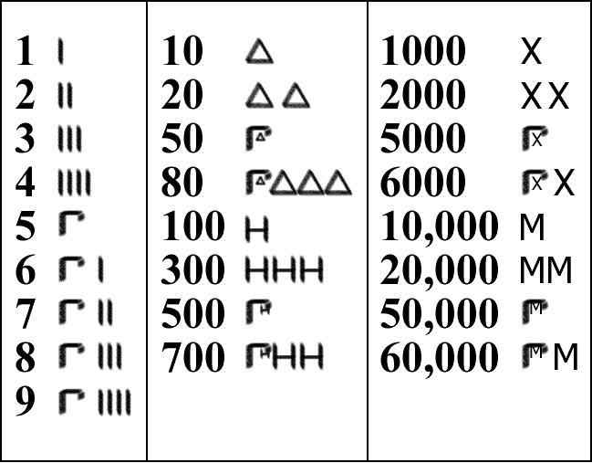
The Greek Numeral System

Slide 19
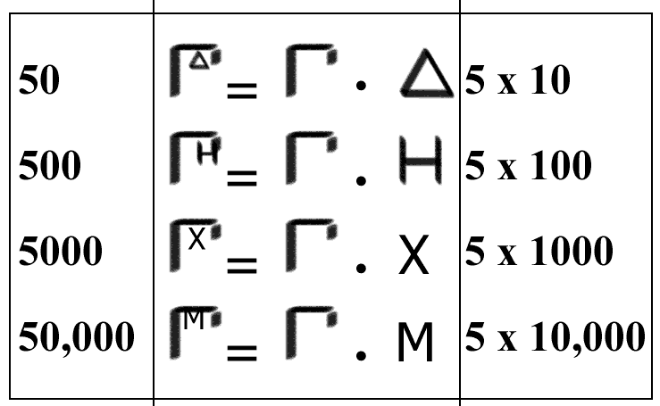
Arithmetic with Greek Numeral System

Slide 20
Roman Numerals
I 20 XX
2 II 25 XXV
3 III 29 XIX
4 IV 50 L
5 V 75 LXXV
6 VI 100 C
10 X 500 D
11 XI 1000 M
16 XVI
Now try these:
XXXVI
XL
XVII
DCCLVI
MCMLXIX

Slide 21
Roman Numerals – Task 1
 | CCLXIV
+ | DCL
+ | MLXXX
+ | MDCCCVII
 | LXXV
x | L
 | MMMDCCXXVIII
- | MDCCCLII
- | MCCXXXI
- | CCCCXIII

Slide 22
Roman Numerals – Task 1
 | CCLXIV
+ | DCL
+ | MLXXX
+ | MDCCCVII
 | 264
+ | 650
+ | 1080
+ | 1807
MMMDCCCI
3801

Slide 23
Roman Numerals – Task 1
 | MMMDCCXXVIII
- | MDCCCLII
- | MCCXXXI
- | CCCCXIII
 | 3728
- | 1852
- | 1231
- | 413
CCXXXII
232

Slide 24
Roman Numerals – Task 1
 | LXXV
x | L
 | 75
x | 50
MMMDCCL
3750

Slide 25
Drawbacks of positional numeral system
Hard to represent larger numbers
Hard to do arithmetic with larger numbers, trying do 23456 x 987654
Notes:
Hard to represent larger numbers
Hard to do arithmetic with larger numbers, trying do 23456 x 987654

Slide 26
The search was on for portable representation of numbers
To make progress, humans had to solve a tricky problem:
What is the smallest set of symbols in which the largest numbers can in theory be represented?
Notes:
The search was on for portable representation of numbers
To make progress, humans had to solve a tricky problem:
What is the smallest set of symbols in which the largest numbers can in theory be represented?

Slide 27
Positional Notation
… | Hundreds | Tens | Units
 | 5 | 7 | 3

Slide 28

South American Maths
The Maya
The Incas

Slide 29


Mayan Maths
twenties | units
2 x 20 + 7 = 47
twenties | units
18 x 20 + 5 = 365

Slide 30
Babylonian Maths
The Babylonians

Slide 31
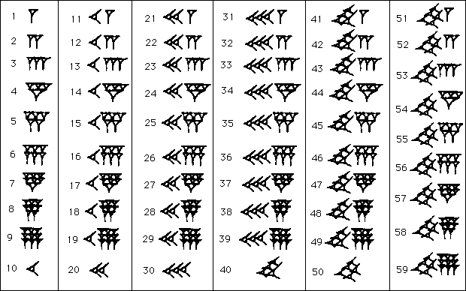
B a b y l o n
I a n
sixties | units
=64
3600s | 60s | 1s
= 3604

Slide 32
Zero and the Indian Sub-Continent Numeral System
You know the origin of the positional number, and its drawbacks.
One of its limits is how do you represent tens, hundreds, etc.
A number system to be as effective as ours, it must possess a zero.
In the beginning, the concept of zero was synonymous with empty space.
Some societies came up with solutions to represent “nothing”.
The Babylonians left blanks in places where zeroes should be.
The concept of “empty” and “nothing” started becoming synonymous.
It was a long time before zero was discovered.
Notes:
You know the origin of the positional number, and its drawbacks.
One of its limits is how do you represent tens, hundreds, etc.
A number system to be as effective as ours, it must possess a zero.
In the beginning, the concept of zero was synonymous with empty space.
Some societies came up with solutions to represent “nothing”.
The Babylonians left blanks in places where zeroes should be.
The concept of “empty” and “nothing” started becoming synonymous.
It was a long time before zero was discovered.

Slide 33
Cultures that Conceived “Zero”
Zero was conceived by these societies:
Mesopotamia civilization 200 BC – 100 BC
Maya civilization 300 – 1000 AD
Indian sub-continent 400 BC – 400 AD
Notes:
We have to thank the Indians for our modern number system.
Similarity between the Indian numeral system and our modern one:

Slide 34
Zero and the Indian Sub-Continent Numeral System
We have to thank the Indians for our modern number system.
Similarity between the Indian numeral system and our modern one

Slide 35
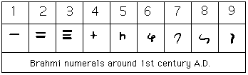
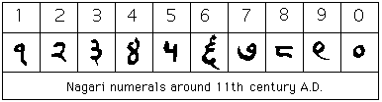
Indian Numbers

Slide 36
From the Indian sub-continent to Europe via the Arabs

Slide 37
Binary Numbers

Slide 38
Different Bases
Base 10 (Decimal):
hundreds | tens | units
1 | 2 | 5
125₁₀ = 1 x 100 + 2 x 10 + 5
Base 2 (Binary):
eights | fours | twos | units
1 | 1 | 1 | 0
1110₂ = 1 x 8 + 1 x 4 + 1 x 2 + 0
= 14 (base 10)

Slide 39
Practice! Binary Numbers
eights | fours | twos | ones
0 | 1 | 0 | 1
0101₂ = 4 + 1 = 5₁₀
Converting bases |  |  | Sums with binary numbers
0110₂ | = | ?₁₀ | 0010₂ + 0001₂ | = | 0011₂
1100₂ | = | ?₁₀ | 0110₂ + 0001₂ | = | ?₂
1111₂ | = | ?₁₀ | 0101₂ + 1010₂ | = | ?₂
?₂ | = | 7₁₀ | 0011₂ + 0001₂ | = | ?₂
?₂ | = | 14₁₀ | 0011₂ + 0101₂ | = | ?₂

Slide 40
Irrationals and Imaginaries

Slide 41
Pythagoras’ Theorem
a² = b² + c²
a
b
c

Slide 42
Pythagoras’ Theorem
a² = 1² + 1²
So a² = 2
a = ?
a
1
1

Slide 43
Square roots on the number line
√1
√4
√9
-5
-4
-3
-2
-1
0
1
2
3
4
5
6
7
√2

Slide 44
Square roots of negatives
Where should we put √-1 ?
√-1=i
√1
√4
√9
-5
-4
-3
-2
-1
0
1
2
3
4
5
6
7
√2

Slide 45
Imaginary numbers
√-4 = √(-1 x 4)
= √-1 x √4
= 2i
√-1=i

Slide 46
Imaginary numbers
4i
Imaginary nums
3i
2i
i
√1
√4
√9
-5
-4
-3
-2
-1
0
1
2
3
4
5
6
7
Real nums
√2

Slide 47
Take Home Messages
The number system we have today have come through a long route, and mostly from some far away lands, outside of Europe.
They came about because human beings wanted to solve problems and created numbers to solve these problems.
Numbers belong to human culture, and not nature, and therefore have their own long history.
Notes:
The number system we have today have come through a long route, and mostly from some far away lands, outside of Europe.
They came about because human beings wanted to solve problems and created numbers to solve these problems.

Slide 48
Questions to Ask Yourselves
Is this the end of our number system?
Are there going to be any more changes in our present numbers?
In 300 years from now, will the numbers have changed again to be something else?
Notes:
Questions to Ask Yourselves

Slide 49
3 great ideas made our modern number system
Our modern number system was a result of a
conjunction of 3 great ideas:
the idea of attaching to each basic figure graphical signs which were removed from all intuitive associations, and did not visually evoke the units they represented
the principle of position
the idea of a fully operational zero, filling the empty spaces of missing units and at the same time having the meaning of a null number

