Slide 1
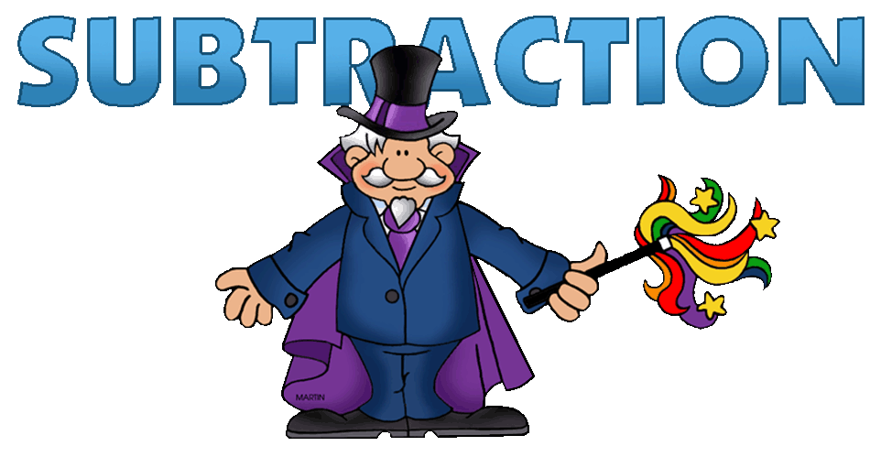
Written by Lin Donn
Illustrated by Phillip Martin

Slide 2
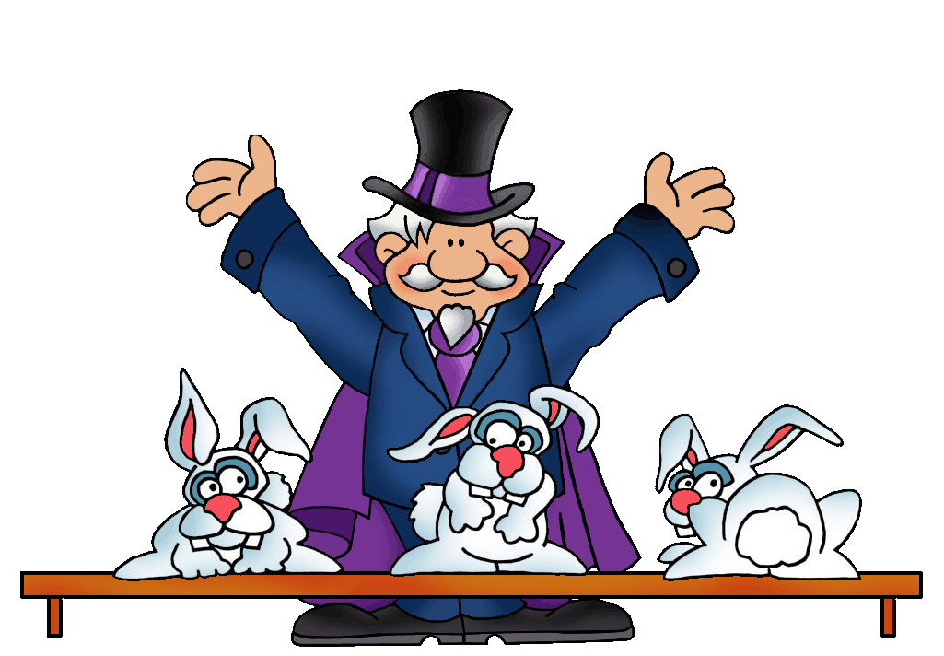
Subtraction
Start
with 3

Slide 3
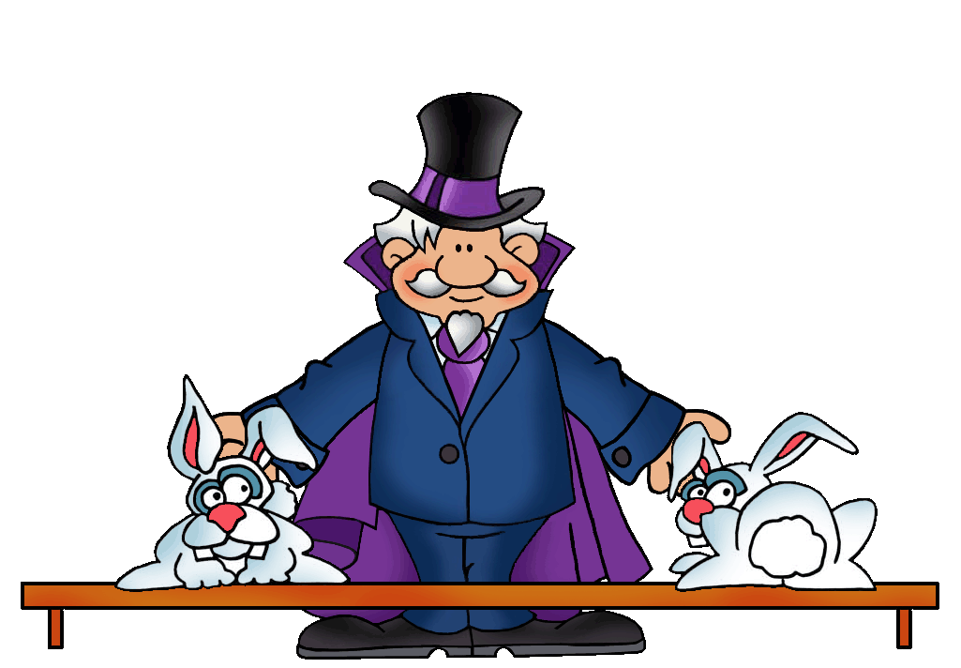
Subtraction
and end
with 2.

Slide 4
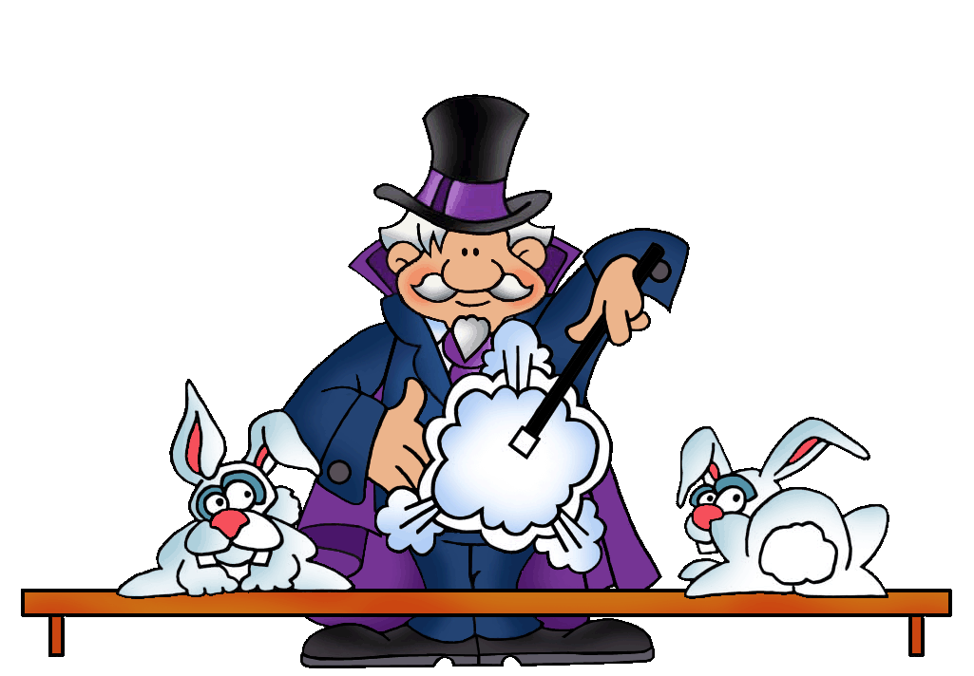
Subtraction
What happened
to 1?

Slide 5
Subtraction

Slide 6
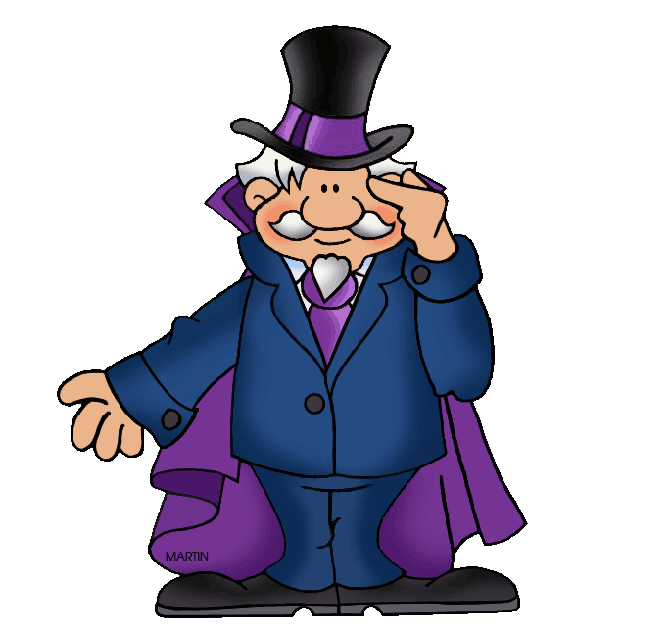
Subtraction
I see. If I understand
this …

Slide 7
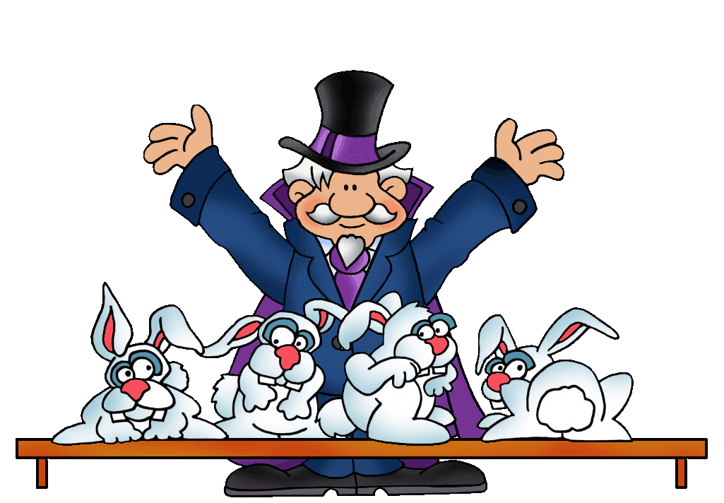
Subtraction
If you
start
with 4

Slide 8
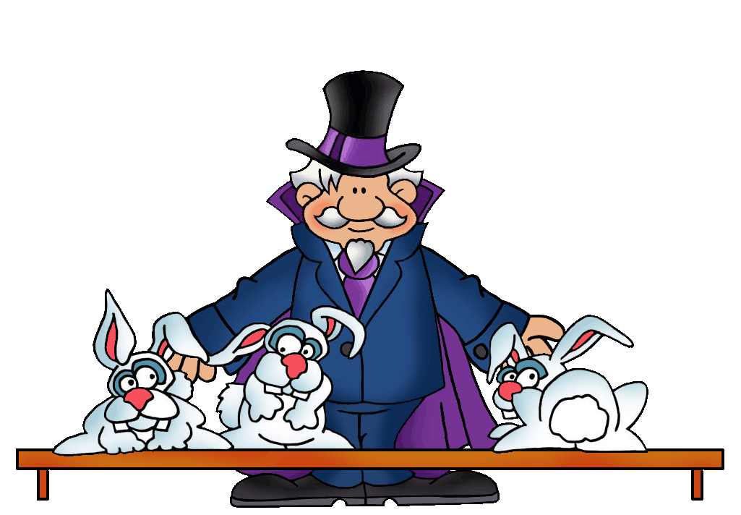
Subtraction
and end
with 3

Slide 9
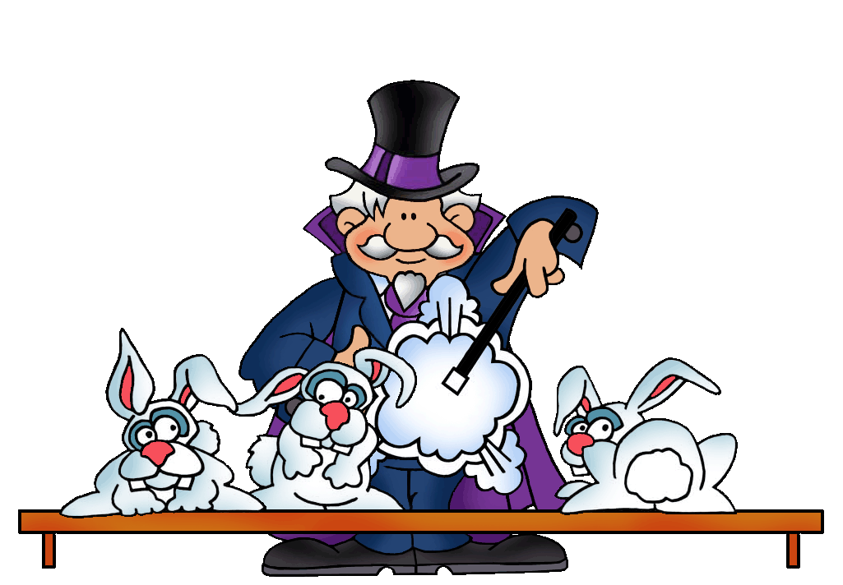
Subtraction
You’ll need
to take
away 1.

Slide 10
Subtraction

Slide 11
Subtraction
But where
does the
1 go?

Slide 12
Subtraction
Does
anyone
know?

Slide 13
This presentation is brought to you by Pete’s Power Point Station. Visit us on the web at PPPST.COM

